Slide 1

PRESENTED BY: ABIGAIL
STRATEGIES TO ELEVATE CUSTOMER SERVICE AND CROSS SELL AT MY BRANCHE

Slide 2


What is Customer Service and Cross Sell?
Customer service is the direct one-on-one interaction between a consumer making a purchase and a representative of the company that is selling it Or the assistance and advice provided by a company to those people who buy or use its products or services.
A good customer service is critical to business success, ensuring brand loyalty to one customer at a time.
On the other hand:
Cross-selling is the process of offering a customer products that are compatible with the ones they're purchasing.
a banker might establish by chance that their customer is looking for a new car and offer an auto loan as a result.

Slide 3

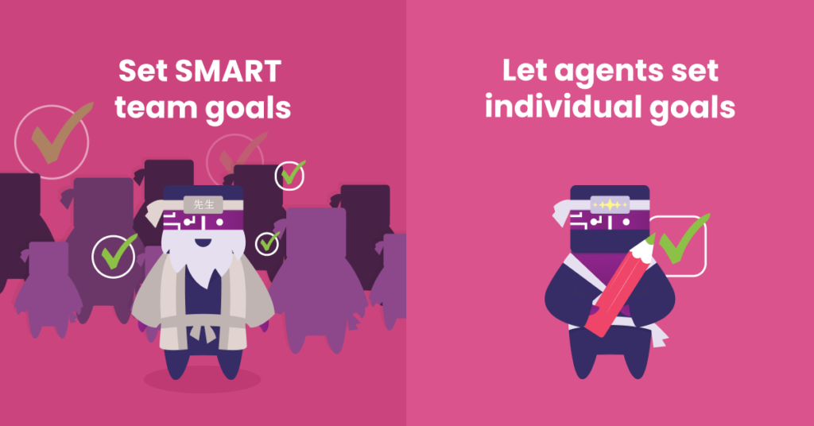
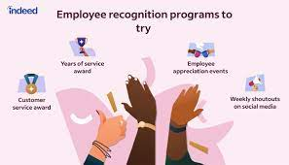

Strategies to Elevate Customer Service
Set up a framework to measure your team’s performance
Set individual and team goals
Set up an employee recognition and rewards program
Get it done the first time

Slide 4


Strategies to Improve Cross Selling
Take advantage of drip emails
Wait until you can provide a win
Match service with client goals
Educate your clients

Slide 5
Conclusion
Recurring revenue is extremely vital for business growth. Without money coming in month-over-month, it can be difficult to predict cash flow and make the necessary investments to grow your business. Yet, finding new customers is a difficult and expensive process.
Furthermore, combining these strategies will empower a team to work together and help each other which can drastically improve a bottom line. Creating a strategy, setting customer service goals, and involving a team in the process that encourages teamwork necessary to succeed.

Slide 6

THANK YOU
THANK YOU

